Slide 1
Pays et nationalités
Découverte du monde – Anglais
⇨ Structures

Slide 2
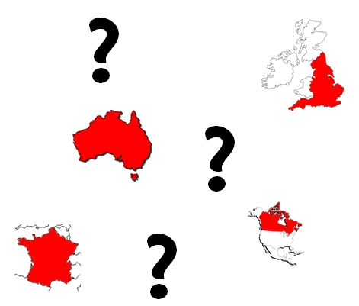
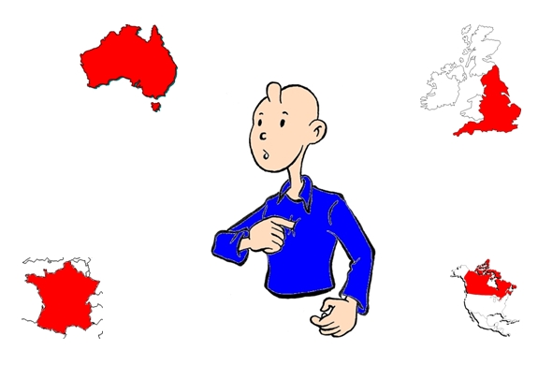
Where are you from ?
I’m from…
Where do you come from ?
I come from…

Slide 3
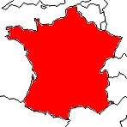
Where are you from ?
I’m from France.

Slide 4
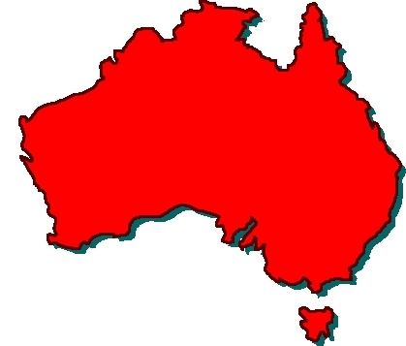
Where do you come from ?
I come from Australia.

Slide 5
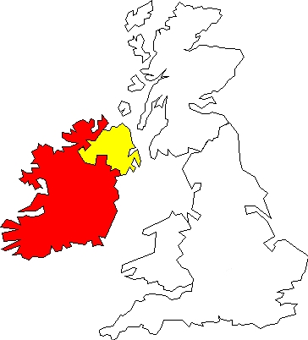
Where are you from ?
I’m from Ireland.

Slide 6
What is your nationality ?
I’m…

Slide 7
What is your nationality ?
I’m Welsh.

Slide 8
What is your nationality ?
I’m American.

Slide 9
What is your nationality ?
I’m English.

