Slide 1
Les couleurs
Découverte du monde – Anglais
⇨ Structures

Slide 2
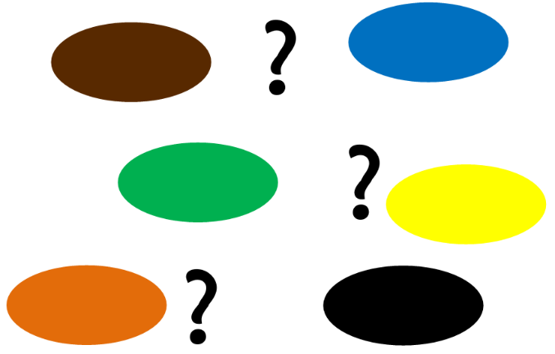
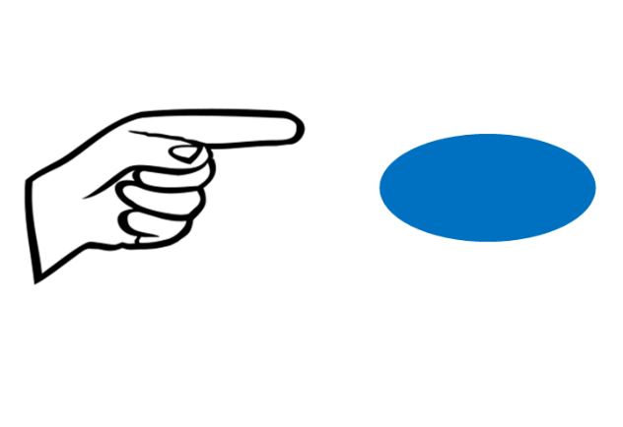
What colour is it ?
It is…

Slide 3
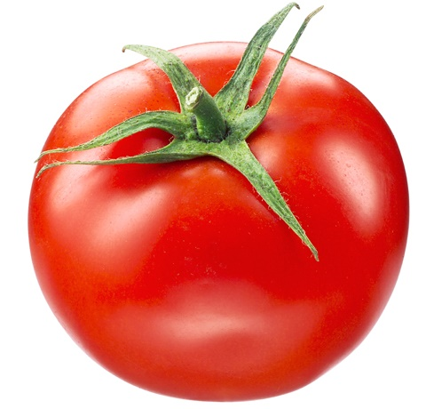
What colour is it ?
It is red.

Slide 4
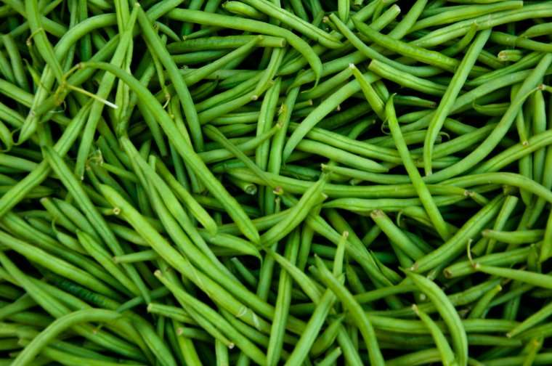
What colour is it ?
It is green.

Slide 5
What colour is it ?
It is white and black.

Slide 6
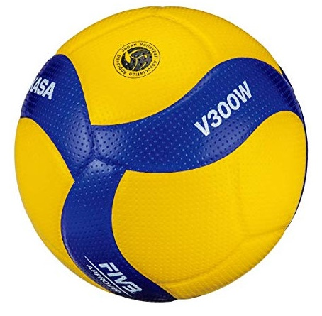
What colour is it ?
It is yellow and blue.

Slide 7
Is it … ?
Yes, it is.
No, it isn’t.

Slide 8
Is it purple ?
No, it isn’t.

Slide 9
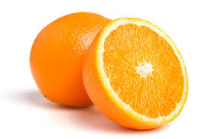
Is it orange ?
Yes, it is.

Slide 10
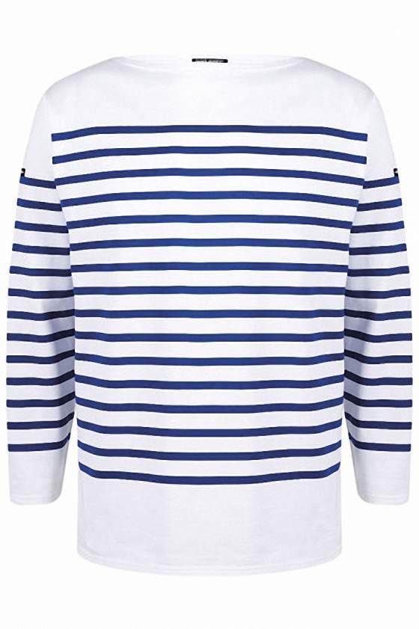
Is it white and blue ?
Yes, it is.

Slide 11
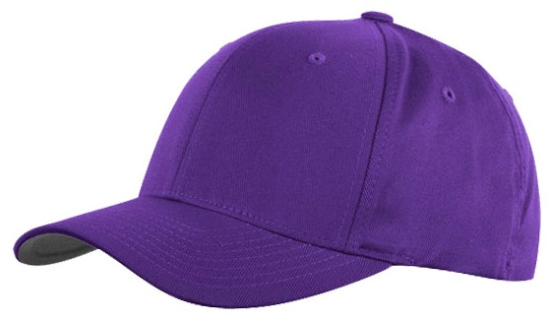
Is it black ?
No, it isn’t.

