Slide 1
Les animaux de compagnie
Découverte du monde – Anglais
⇨ Write the numbers

Slide 2
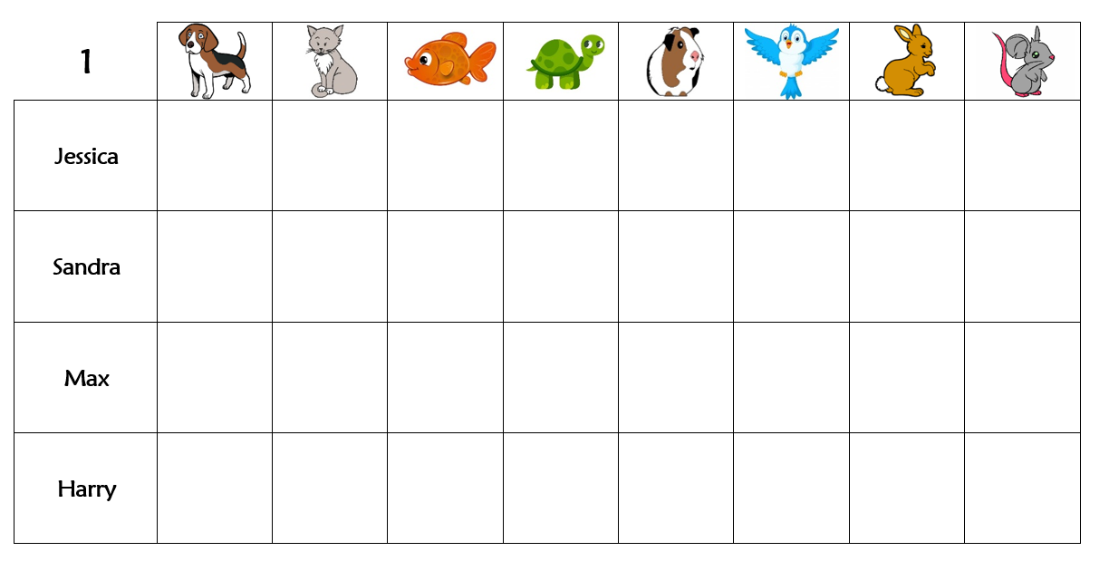
Listen and write the number of pets each person has.
❶
❷
❸
❹

Slide 3
Let’s correct.
2
4
4
2
3
1
2
3
❶
❷
❸
❹

Slide 4
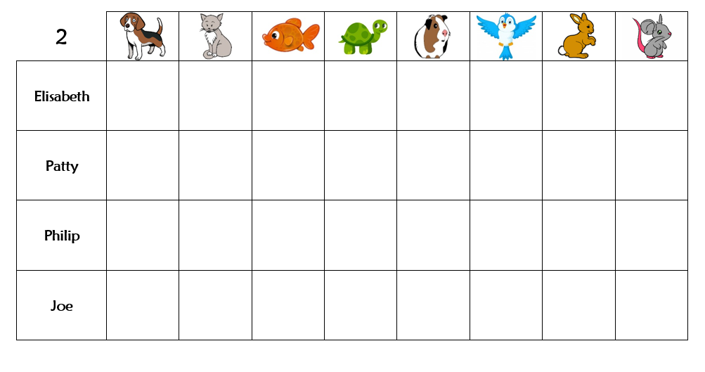
Listen and write the number of pets each person has.
❶
❷
❸
❹

Slide 5
Let’s correct.
2
5
1
2
3
4
2
6
1
1
3
❶
❷
❸
❹

