Slide 1
La ville
Découverte du monde – Anglais
⇨ Find and look

Slide 2
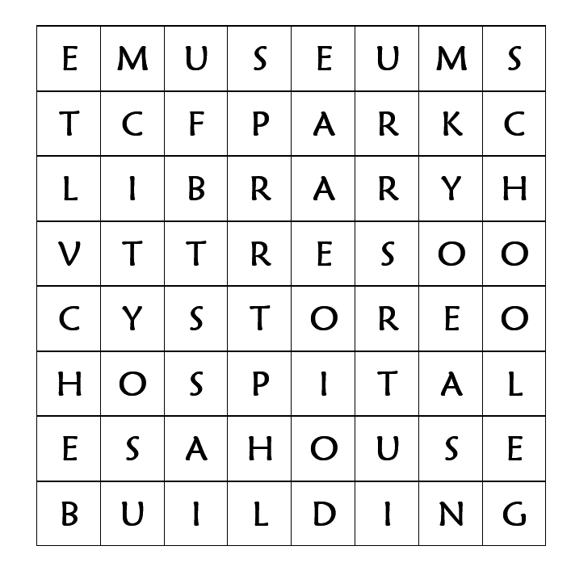
1 - Find and circle the words.

Slide 3
Let’s correct.

Slide 4
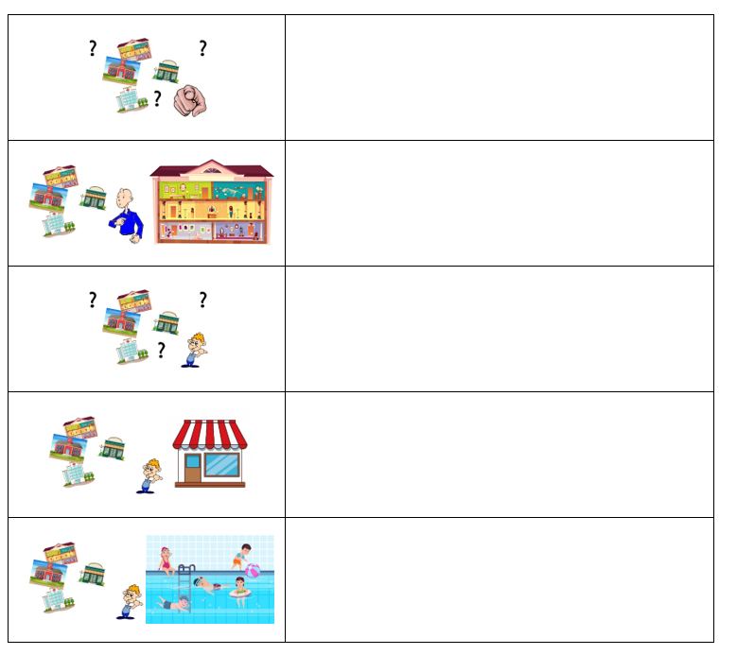
2 - Look at the pictures and write the sentences.

Slide 5
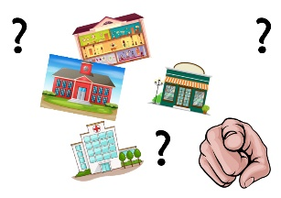
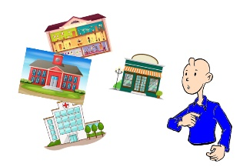
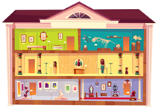
Let’s correct.
Where are you going ?
I’m going to the museum.

Slide 6
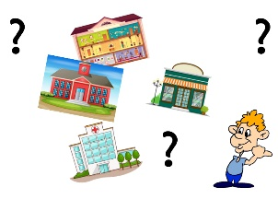
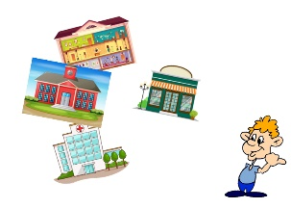
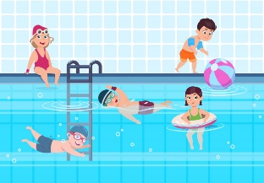
Let’s correct.
Where is he going ?
Where is she going ?
He’s going to the store.
She’s going to the store.
He’s going to the swimming pool.
She’s going to the swimming pool.

