Slide 1
La météo
Découverte du monde – Anglais
⇨ Chanson sur la météo

Slide 2
Try to find words you know in the song.

Slide 4
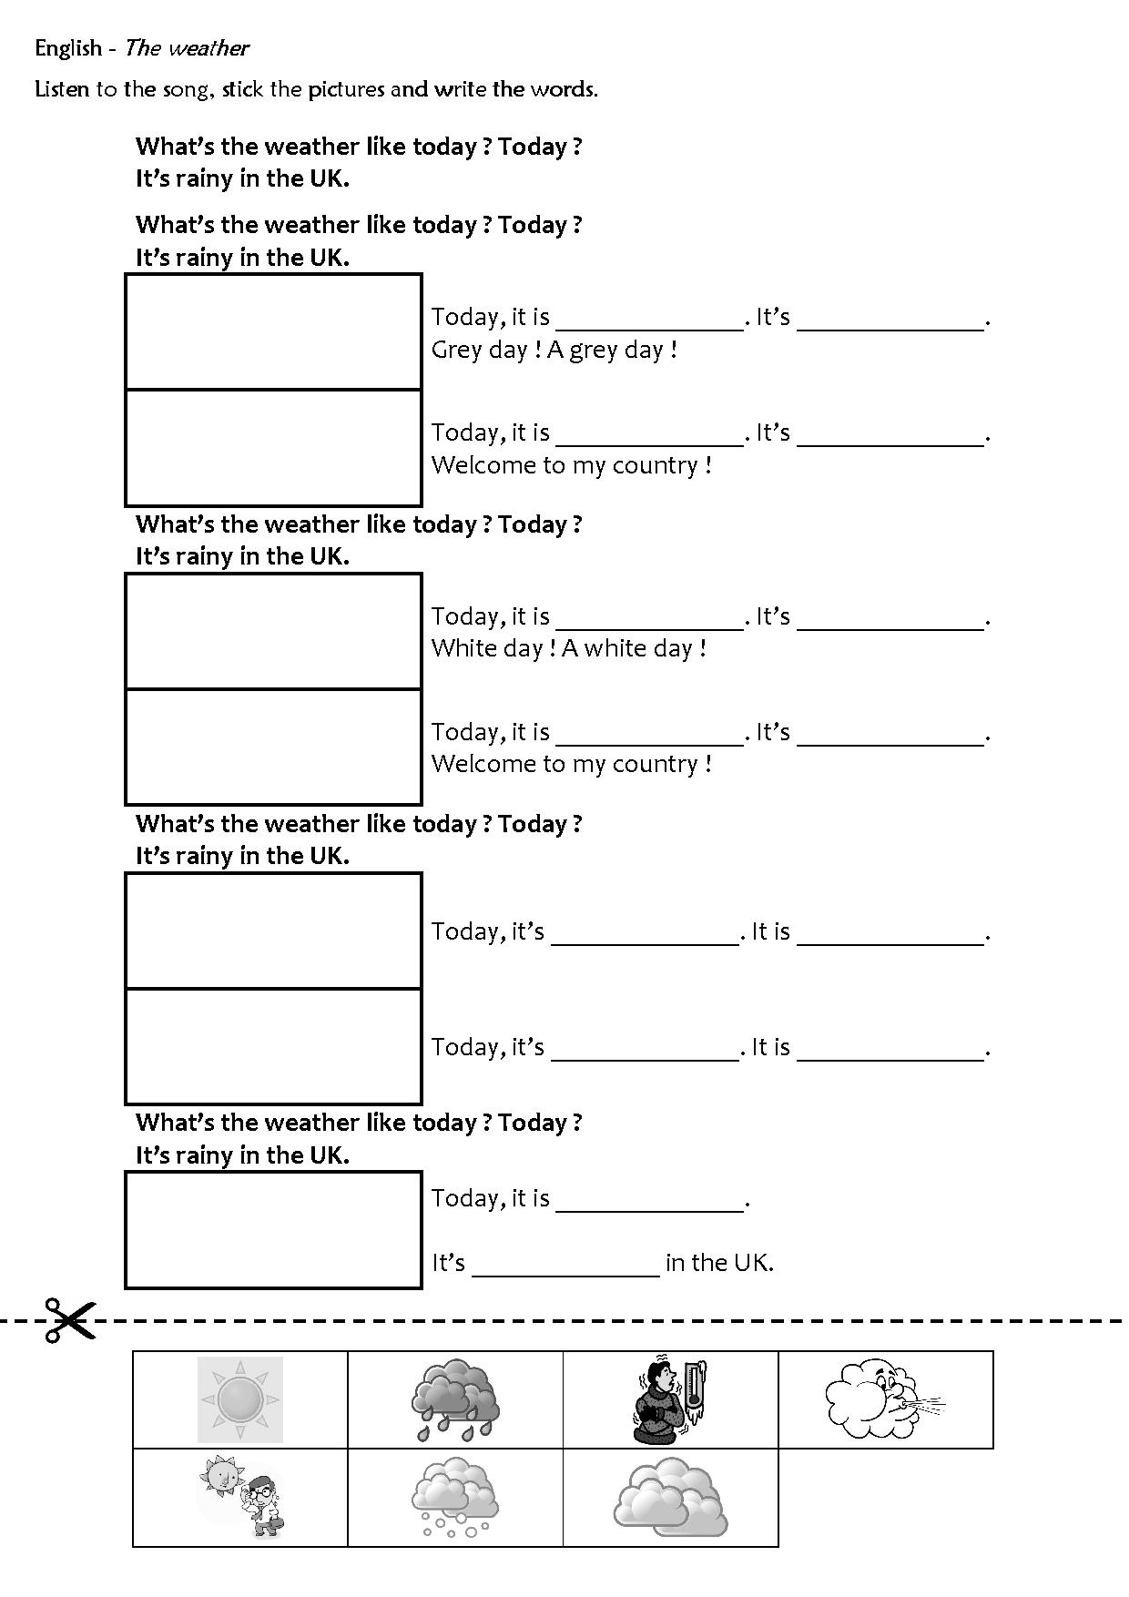
stick the pictures
Listen to the song,
and write the words.

Slide 5
3
1
2
Let’s go !

Slide 7
Let’s correct the exercise.

Slide 8
Let’s correct the exercise.

Slide 9
Let’s correct the exercise.

Slide 10
Let’s correct the exercise.

Slide 11
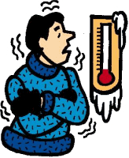
Let’s correct the exercise.

Slide 12
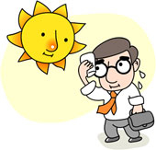
Let’s correct the exercise.

Slide 13
Let’s correct the exercise.

Slide 14
Now, let’s sing the song !

